Slide 1
Divide & Conquer, Greedy and Dynamic Programming Algorithms
Muhammad Waqas Sheikh
FAST University, Karachi Campus

Slide 2
Divide & Conquer
Divide and conquer (D&C) is an algorithm design paradigm based on multi-branched recursion
A divide and conquer algorithm works by recursively breaking down a problem into two or more sub-problems
Until these subproblems become simple enough to be solved directly

Slide 3
Divide & Conquer
The solutions to the sub-problems are then combined to give a solution to the original problem
For example
  Merge sort
  Quick sort
  Binary Search
  Sieve Technique

Slide 4
Greedy Algorithm
A greedy algorithm is a mathematical process that looks for
  simple
  easy-to-implement solutions
to complex, multi-step problems by deciding which next step will provide the most obvious benefit.

Slide 5
Greedy Algorithm
Prim’s Algorithm (Minimum Spanning Trees)
Kruskal’s Algorithm (Minimum Spanning Trees)
Dijsktra Algorithm (Single Source Shortest Path)

Slide 6
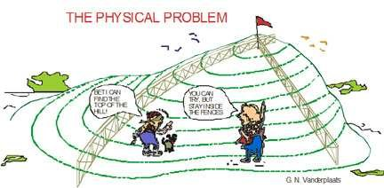

Slide 7
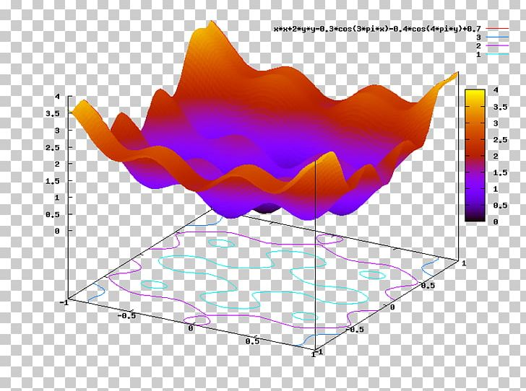

Slide 8
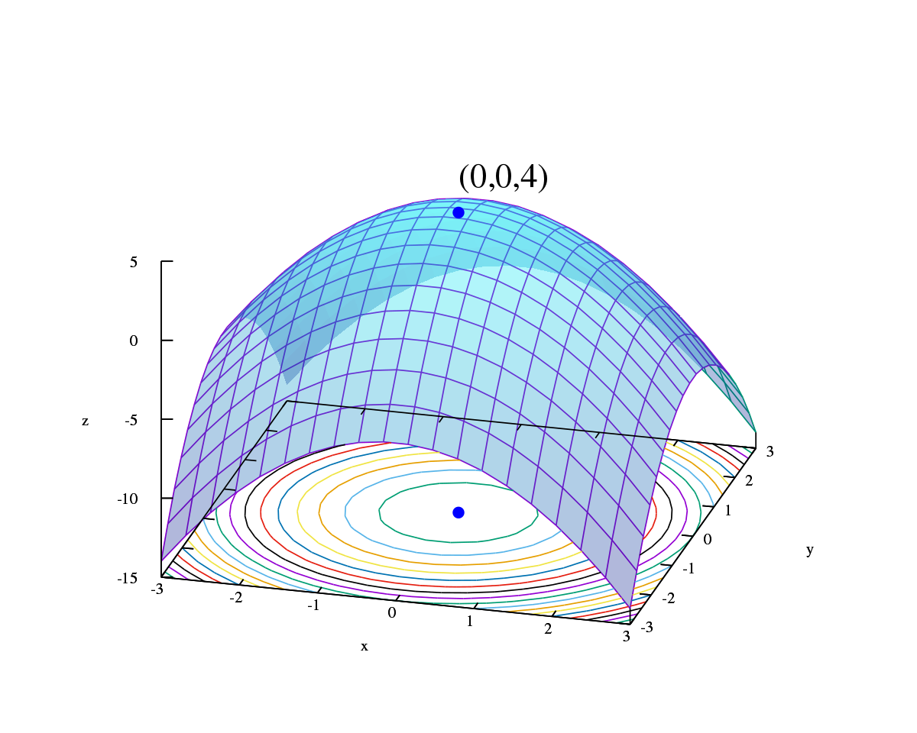

Slide 9

Dynamic Programming
Dynamic Programming is a general algorithm design technique
for solving problems defined by or formulated as recurrences with overlapping sub-instances
Invented by American mathematician Richard Bellman in the 1950s to solve optimization problems and later assimilated by CS

Slide 10
Dynamic Programming
“Programming” here means “planning”
Main idea:
    set up a recurrence relating a solution to a larger instance to solutions of some smaller instances
    - solve smaller instances once
    record solutions in a table
    extract solution to the initial instance from that table

Slide 11
Dynamic Programming
Dynamic Programming is a technique for algorithm design
It is a tabular method in which we break
  down the problem into subproblems
  and place the solution to the subproblems in a matrix

Slide 12
Dynamic Programming
The matrix elements can be computed:
  iteratively, in a bottom-up fashion
  recursively, using memoization
Dynamic Programming is often used to solve optimization problems

Slide 13
What is dynamic programming?
Subproblems overlap
  Subproblems share sub-subproblems
Sub1
Sub2
Sub3
Sub4
Sub5
Sub4
Sub5
Sub6

Slide 14
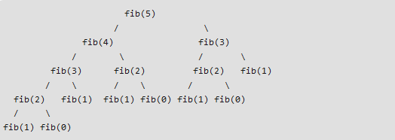
Dynamic Programming

Slide 15
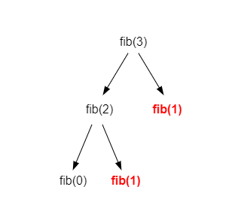
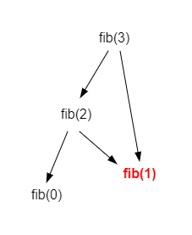

Slide 16
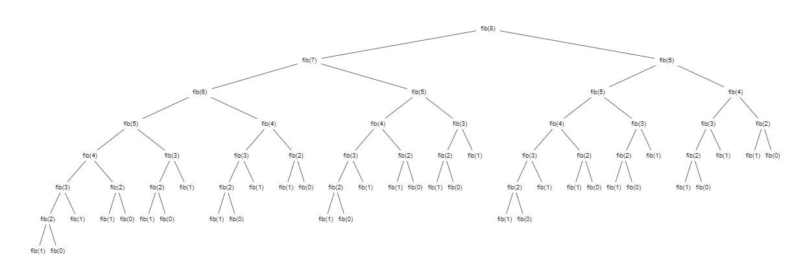

Slide 17
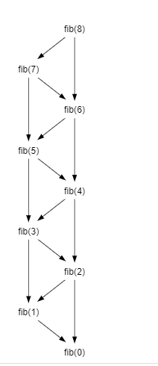

Slide 18
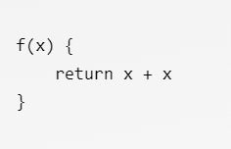
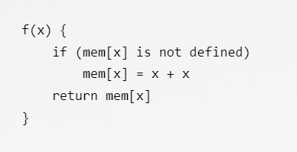
Memoization
Memoization refers to the technique of caching and reusing previously computed results. If you for instance have

Slide 19
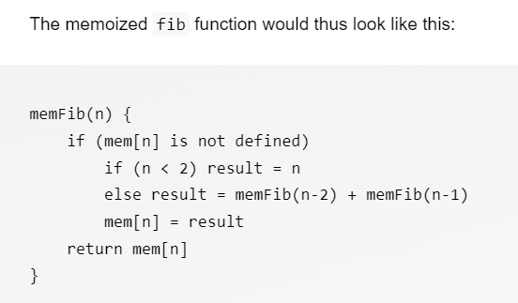

Slide 20
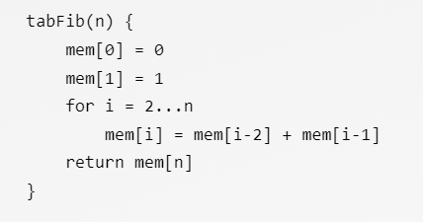
Tabulation
Tabulation is similar but focuses on filling the entries of the cache.
Computing the values in the cache is easiest done iteratively. The tabulation version of fib would look like this:

Slide 21
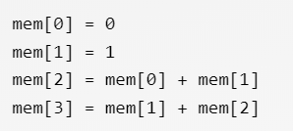
As opposed to the memoization technique, this computation is bottom-up since original problem, fib(3), is at the bottom of the computation.

Slide 22
tabulation or memoization?
If the original problem requires all sub-problems to be solved, tabulation usually outperforms memoization by a constant factor. This is because tabulation has no overhead for recursion and can use a preallocated array rather than, say, a hash map.

Slide 23
tabulation or memoization?
If only some of the sub-problems needs to be solved, for the original problem to be solved, then memoization is preferable since the sub-problems are solved lazily, i.e. precisely the computations needed are carried out.

Slide 24
In the tabulation approach you have more control over what data to save for later. Inside a memorized function it is hard to make a decision on what previous results can be discarded.
I guess the bottom line is this: If you want such finer grained control over memory usage, memoization may not be a viable option.

Slide 25
Tabulation is similar but focuses on filling the entries of the cache.
Computing the values in the cache is easiest done iteratively. The tabulation version of fib would look like this:

Slide 26
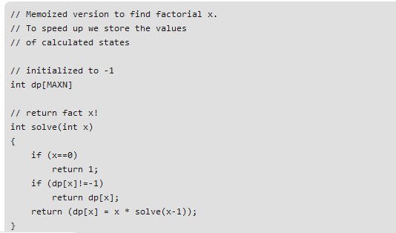

Slide 27
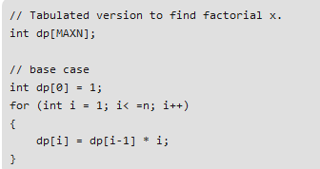

Slide 28
Dynamic Programming
Usually it is sufficient to produce one optimal solution, even though there may be many optimal solutions for a given problem

Slide 29
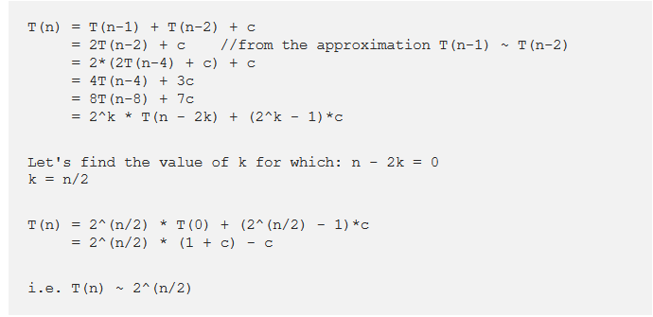
Dynamic Programming

Slide 30
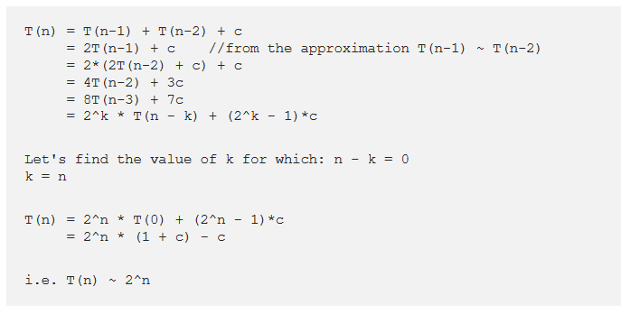
Dynamic Programming

Slide 31
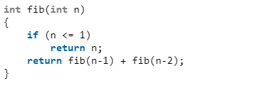
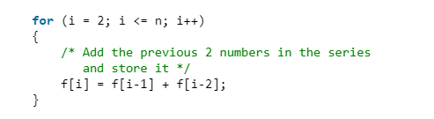

Slide 32
Dynamic Programming
Dynamic programming algorithms
  Solve each subproblem only once
  If solve problems in a top-down manner, record sub problem solutions in a table (named: top-down with memoization)
  If solve the problems in a bottom-up manner, solve the smaller problem first (named: bottom-up method)
In computing, memoization is an optimization technique used primarily to speed up computer programs by having function calls avoid repeating the calculation of results for previously processed inputs.

Slide 33
References
Lecture Slides of
  Haidong Xue at GSU
http://en.wikipedia.org/wiki/

